Slide 1
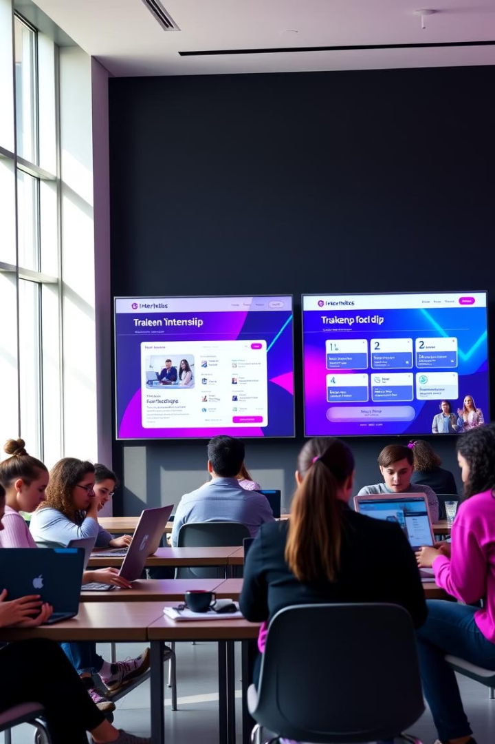
INTERNIX :Connect with top companies and find internships that match your skills and interests.
by Vedang Wajge (62)
Diksha Utekar (63)

Slide 2

INTRODUCTION
The Internship Management System is a comprehensive web-based platform designed to streamline the process of managing internships for both students and employers. It facilitates student and employer authentication, enables employers to post internship opportunities, and allows students to search and apply for them seamlessly. The system provides an organized interface for managing applications, where employers can review, accept, or reject candidates efficiently. By enhancing communication and simplifying administrative tasks, this platform improves accessibility, transparency, and overall user experience in the internship process.

Slide 3
PROBLEM STATEMENT
Many students face challenges in finding suitable internship opportunities due to a lack of centralized platforms, inefficient communication with employers, and limited access to real-time updates. Employers also struggle with managing applications and selecting the right candidates efficiently. There is a need for a comprehensive system that can streamline the internship process by facilitating secure student and employer interactions, allowing employers to post opportunities and recruit candidates, and enabling students to apply and track their application status seamlessly. This system will enhance transparency, improve efficiency, and provide a better overall experience for both students and employers.

Slide 4
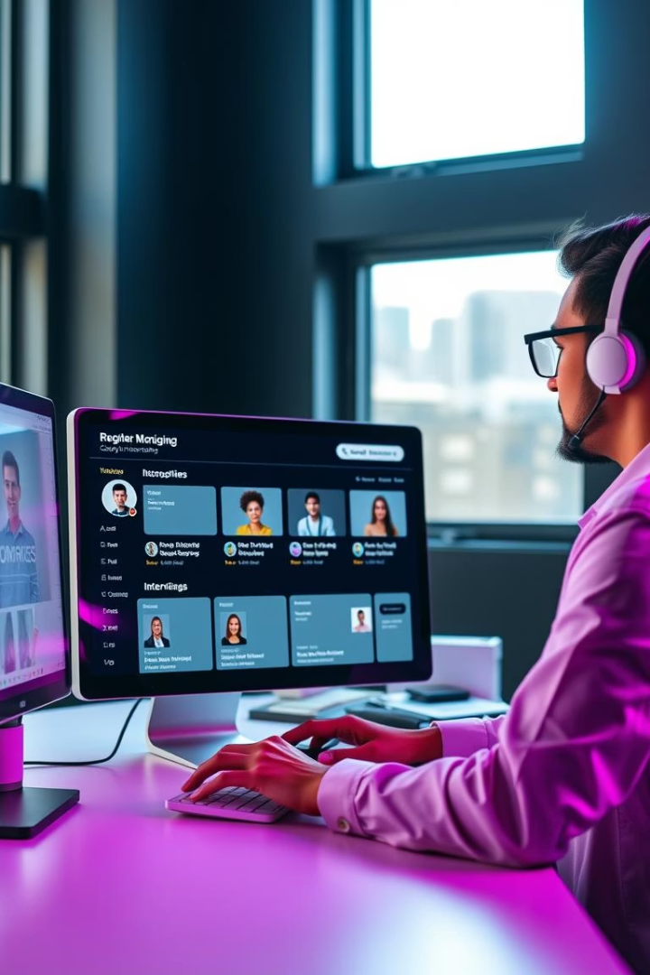
KEY FEATURES
Create Company Profiles
Showcase culture, mission, and values
Post Internship Openings
Quickly publish with detailed descriptions
Manage Applications
View and filter candidates easily
Communicate Directly
Integrated messaging with applicants

Slide 5
TECHNOLOGY STACK
Frontend:
1
JavaScript, html Jinja template, bootstrap
Backend:
2
Flask (Python)
Database:
3
MongoDB (Atlas)
Development Tools
4
VS Code, Postman, Git

Slide 6
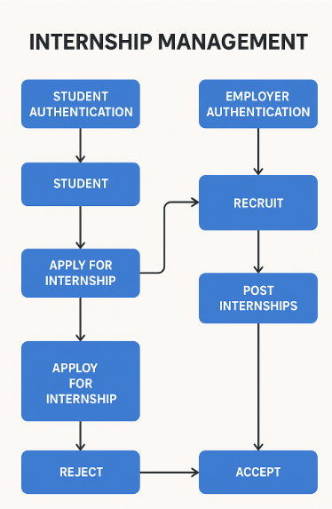
FLOWCHART:

Slide 7
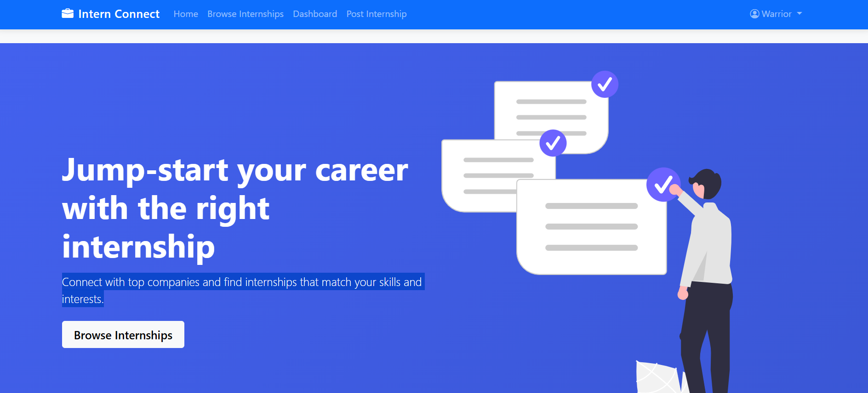
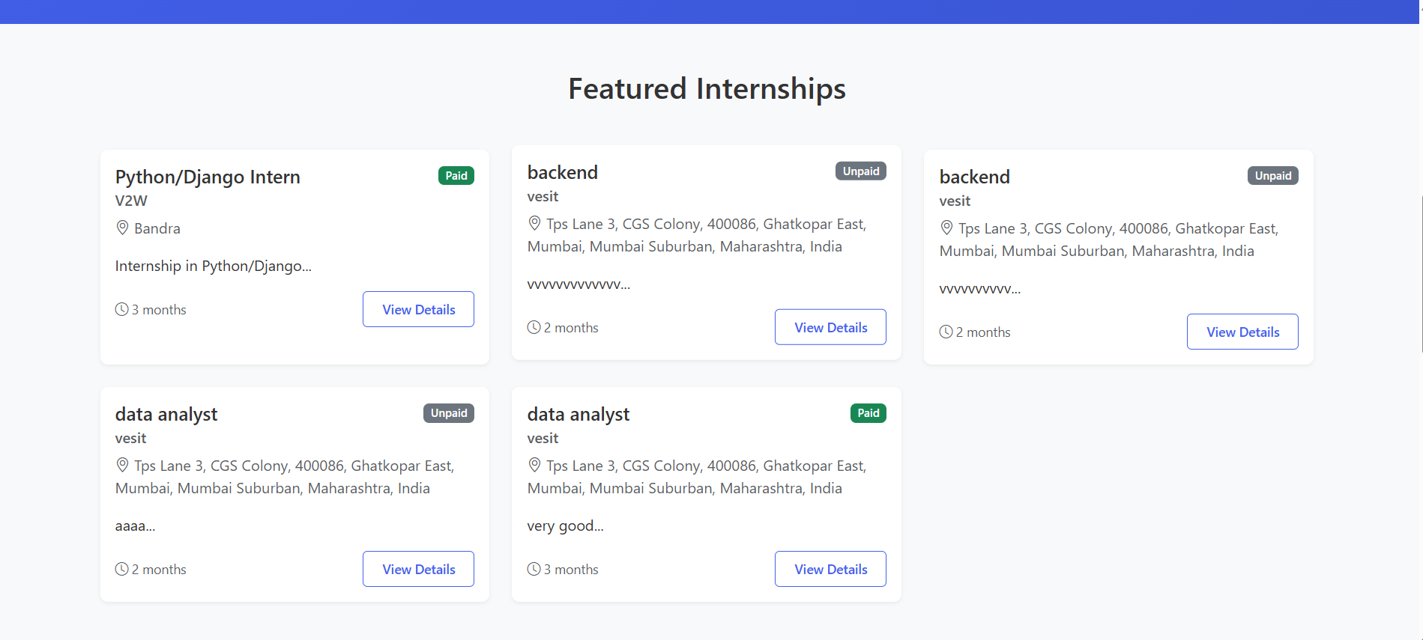
USER INTERFACE

Slide 8
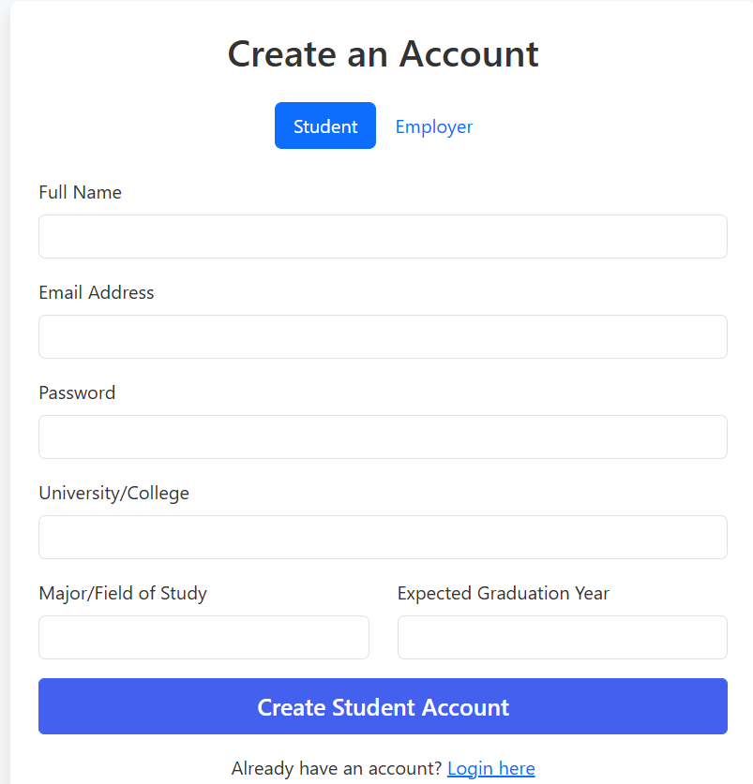
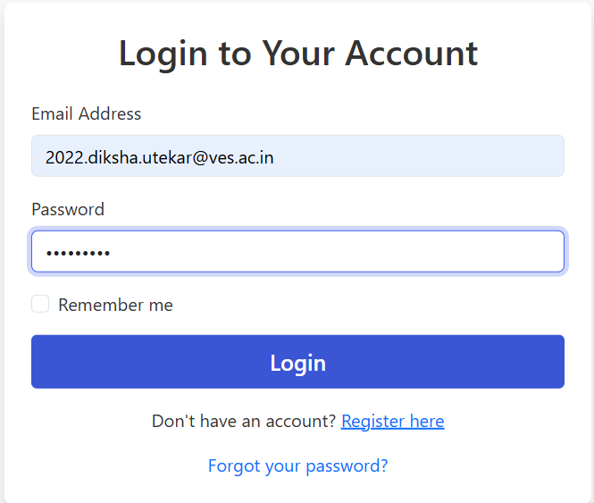
AUTHENTICATION

Slide 9
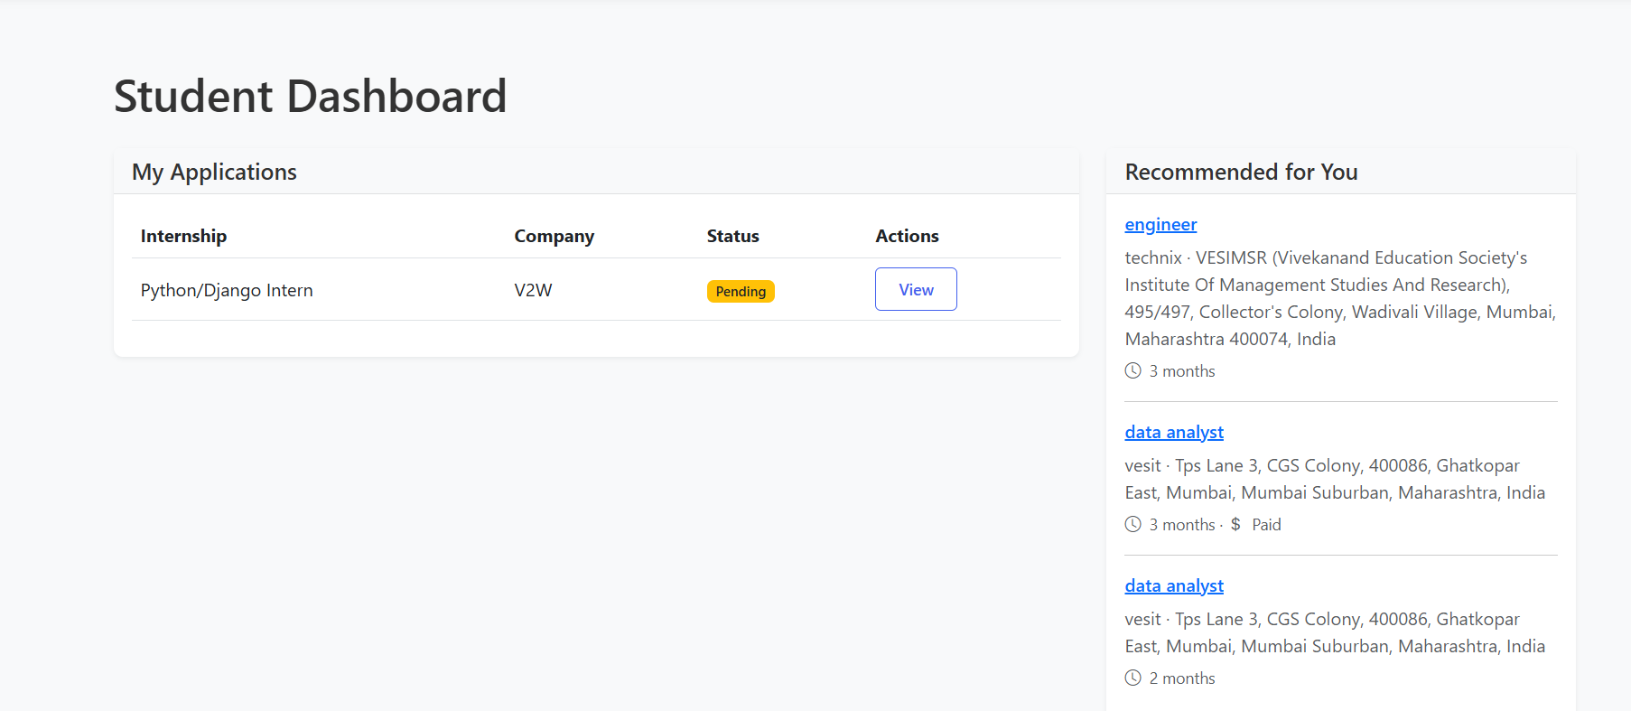
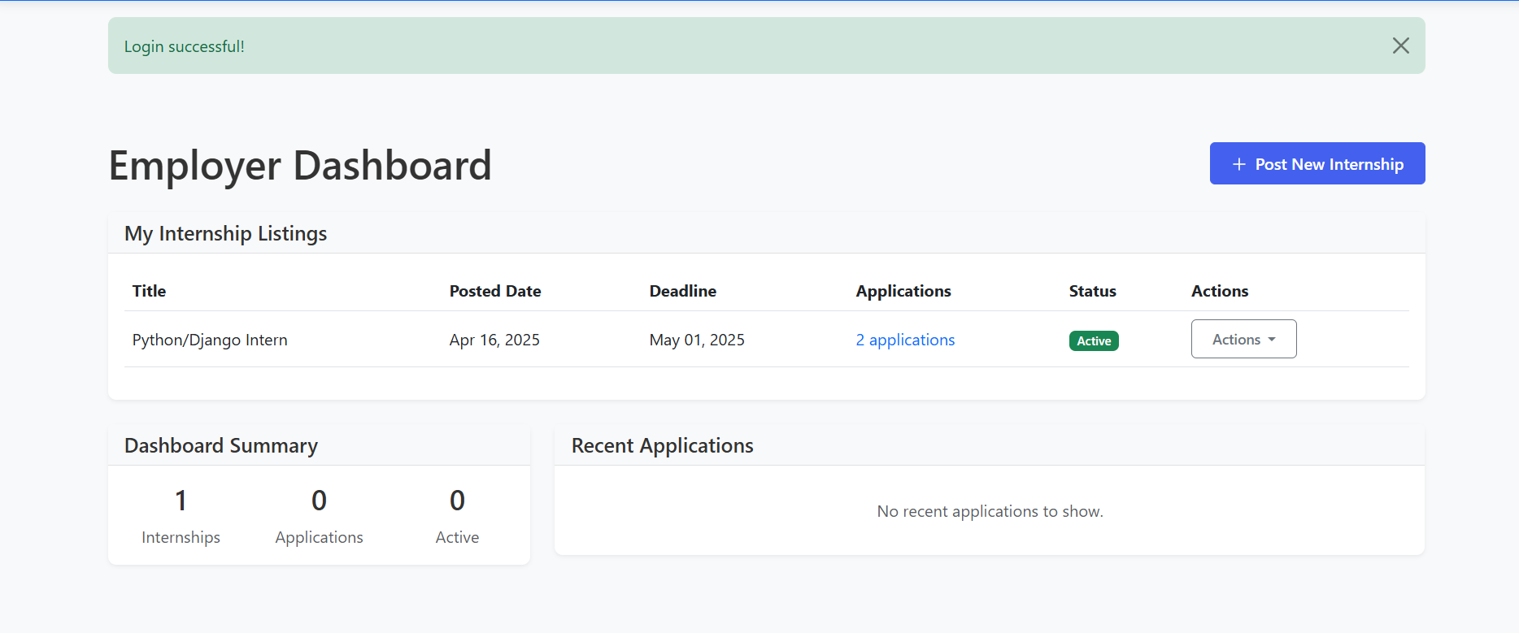
DASHBOARD

Slide 10
FUTURE SCOPE
Real-Time Notifications Integrating real-time alerts for application updates, deadlines, and employer responses to enhance communication.
Analytics and Reporting Adding dashboards for students and employers to track application progress, success rates, and internship performance.
Resume and Document Builder Incorporating tools for students to create, edit, and manage resumes and other required documents directly within the platform.
4o

Slide 11
THANK YOU

